Slide 1



T8
AI In Earthquake Damage Assessment
Arda Erdal
Talha Demirbilek
Ensar Demirbilek

Slide 2

CHALLENGE
Community Mapping
A geographic information system (GIS) can create, manage, analyze, and map many types of data. With GIS and other mapping technologies, you can create a map of an area and layer open data over it spatially to reveal new, enriching insights.

Slide 3
OUR GOAL
By leveraging the power of AI to create an AI image detection model that analyzes, and classifies buildings of a area that was hit by a earthquake. This will allow to know how severe the earthquake was in real time so authorities can analyze and take action accordingly. This will help save thousands of lives and will have massive economic benefits.

Slide 4
WHAT MAKES US DIFFERENT
While doing this project, we used the latest version of algorithms to maximize the accuracy rate and minimize possible errors.
The dataset we used in the project is a mixed data set. This data includes mostly of data that we created ourselves.
The model weights will be open source so anybody who wants use and make improvements on the model can use the previous checkpoint.

Slide 5
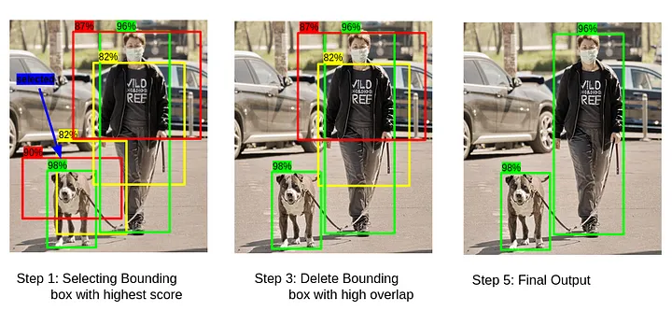
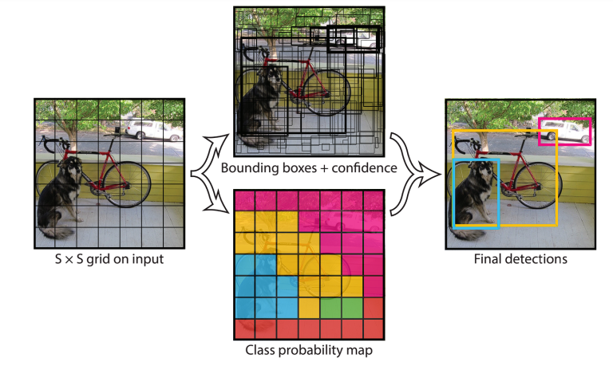
HOW DOES IT WORK

Slide 6
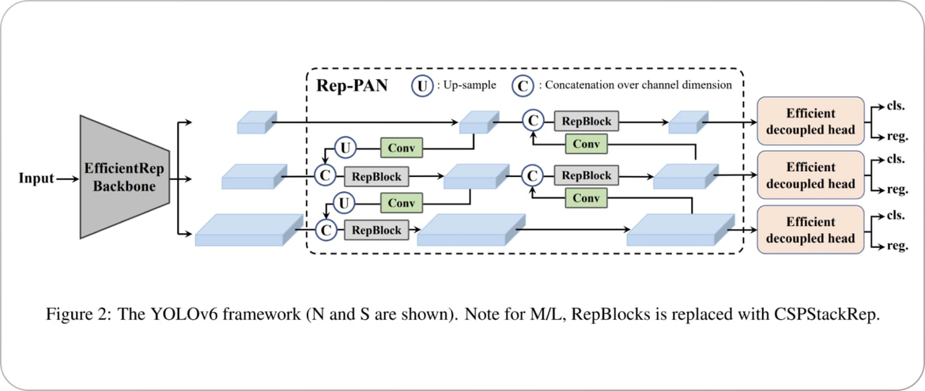
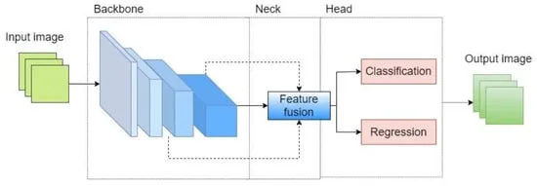
HOW DOES IT WORK

Slide 7
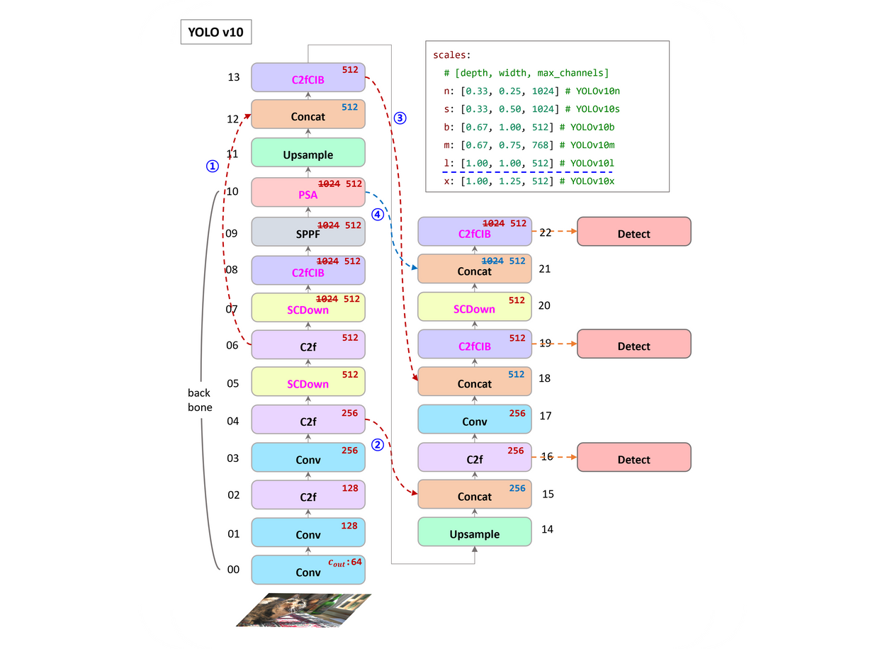
HOW DOES IT WORK

Slide 8
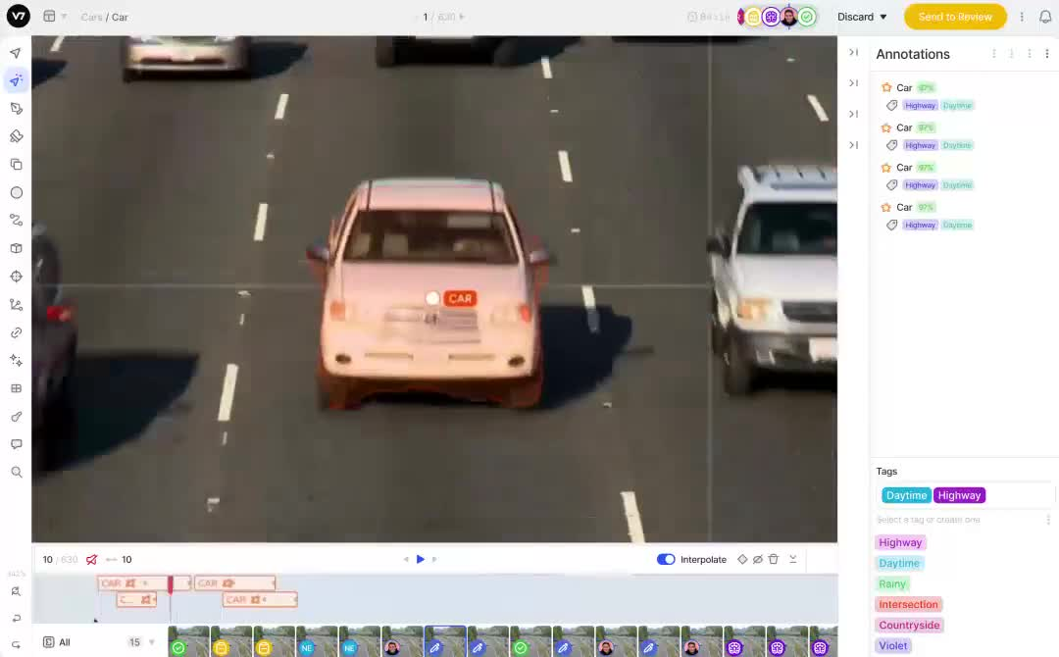
HOW DOES IT WORK

Slide 9
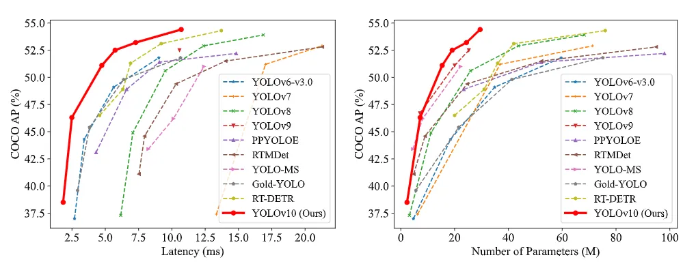
WHY WE CHOSE YOLOV10
Speed and Efficiency
Improved Accuracy
Better Architecture
Customization and Flexibility
Real-Time Performance
Wide Community Support
Applications Across Domains

Slide 10
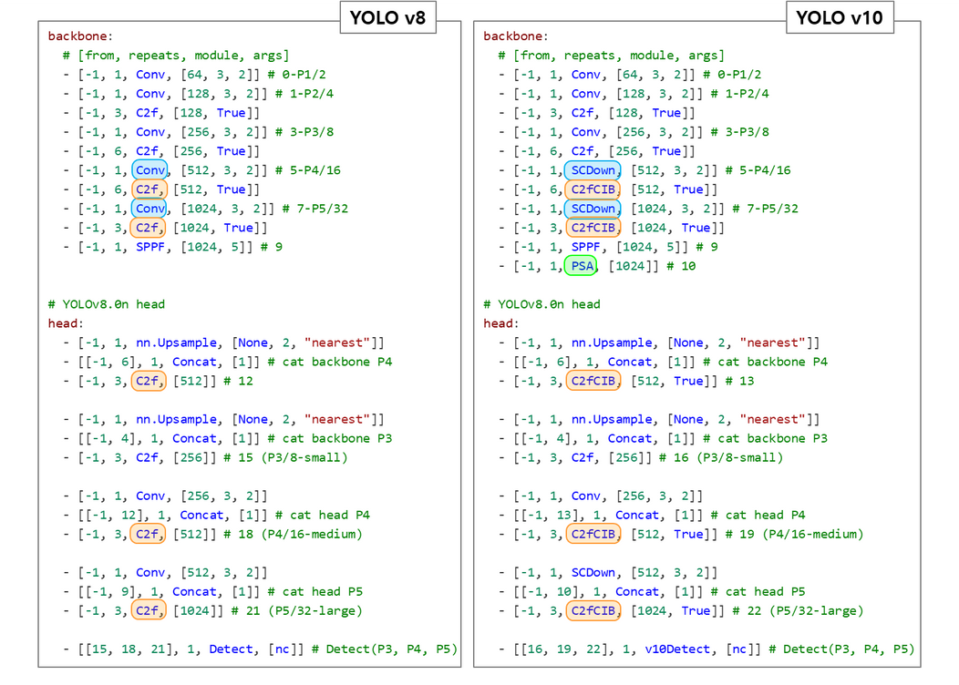
WHY WE CHOSE YOLOV10

Slide 11
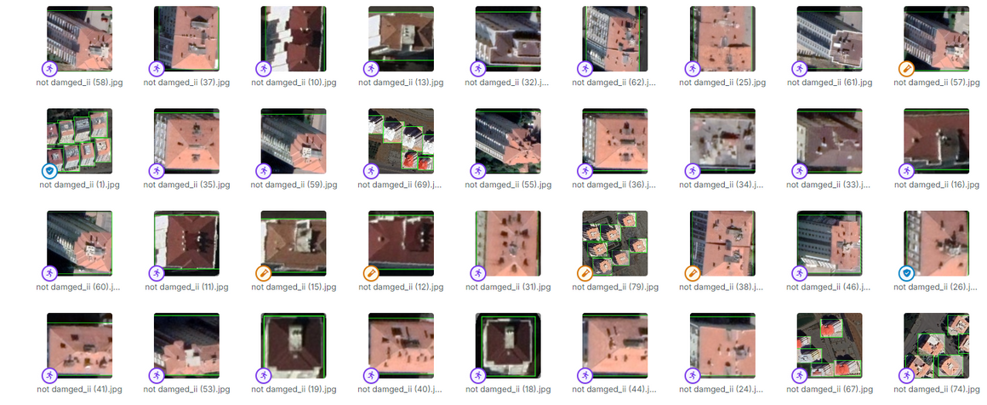
DATASET
The model was trained on a dataset consisting of 842 images.
774 training images
50 validation images
18 testing images

Slide 12
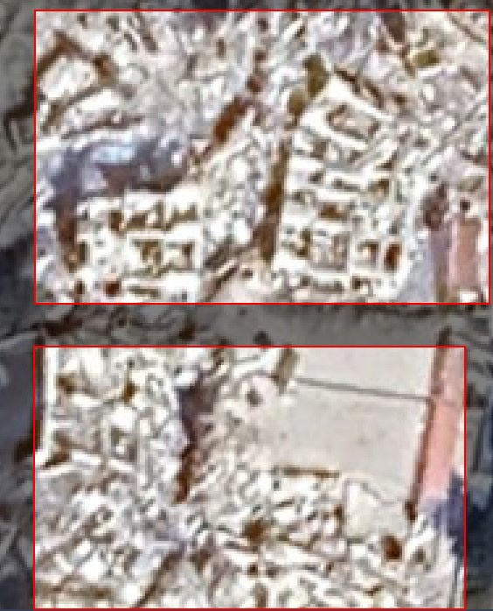
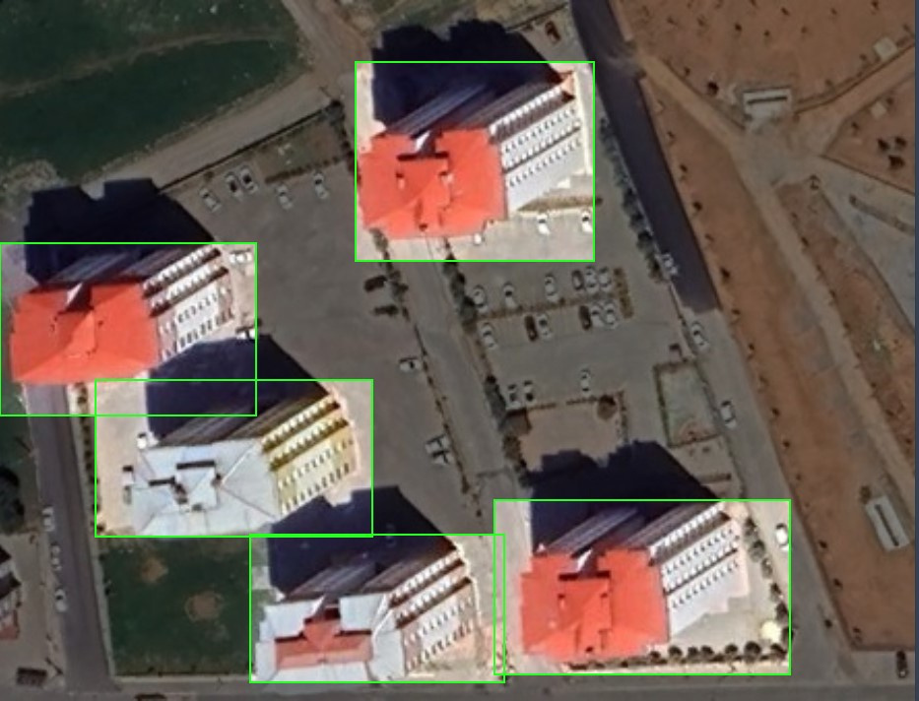
LABELING

Slide 13
DATA PREPROCESSING
Preprocessing data helps to improve the accuracy, reduce the time and resources required to train the model, prevent overfitting, and improve the interpretability of the model
Used preprocessing methods:
Auto-Orient
Resize (640x640)

Slide 14
DATA AUGMENTATION
Data augmentation is a technique used to artificially increase the size and diversity of a training dataset and helps prevent overfitting when you're training Machine Learning models.
Used data augmentation methods:
90 degree rotation
Rotation between -15 and +15 degrees
Exposure between -15% and +15%
Noise up to 1.01% of pixels

Slide 15
TRAINING
The model was trained in GoogleColab with T4 GPU
50 epochs
Batch size of 16
Image size: 640
Patience: 100 (to stop overfitting)
Optimizer: AdamW
Learning rate: 0.001667
Momentum: 0.9

Slide 16
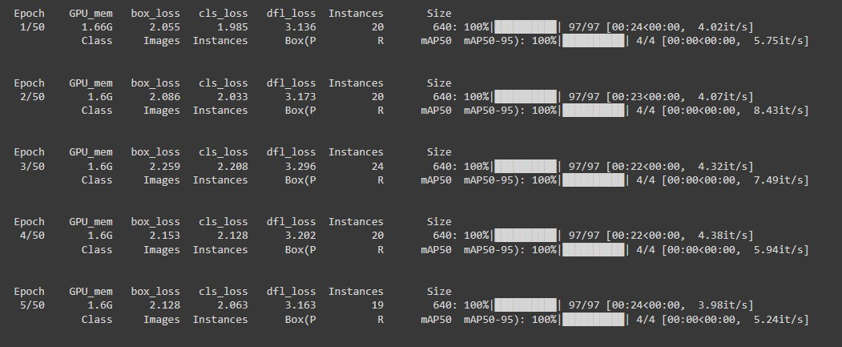
TRAINING

Slide 17
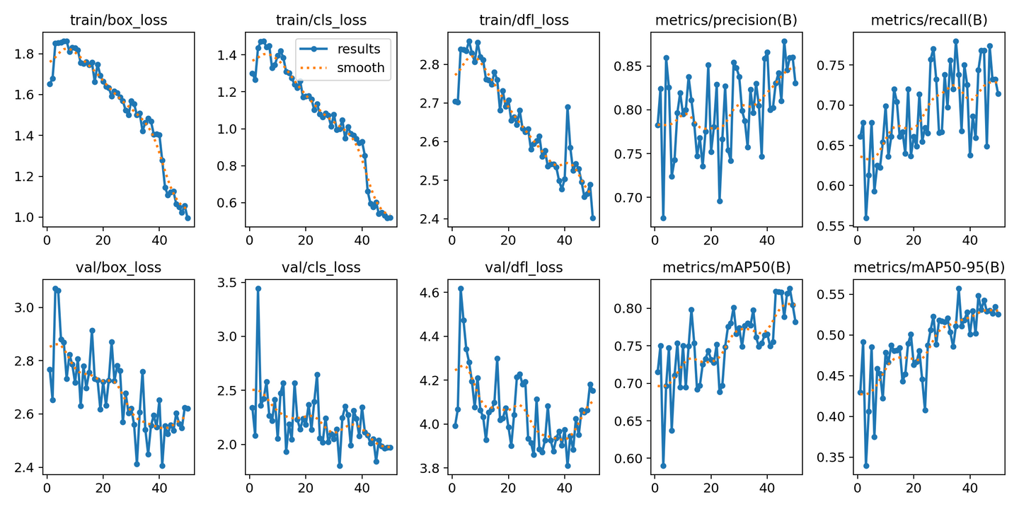
TRAINING

Slide 18
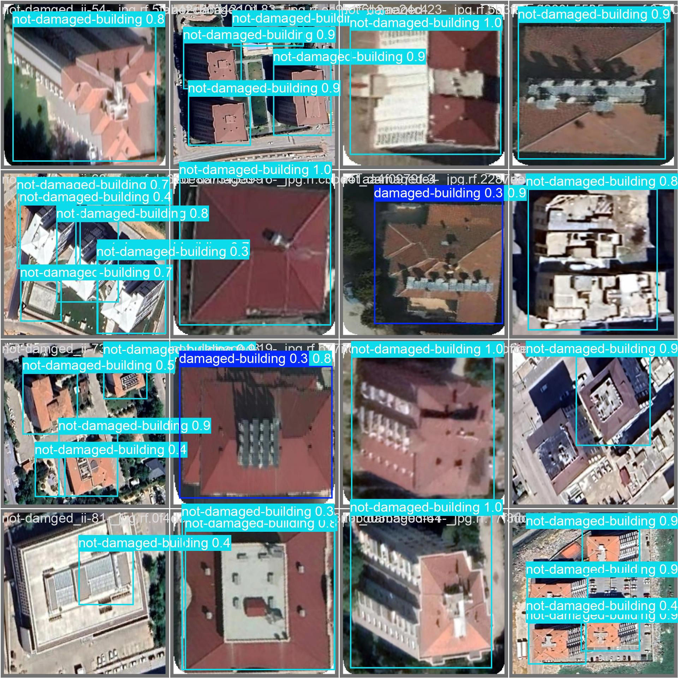
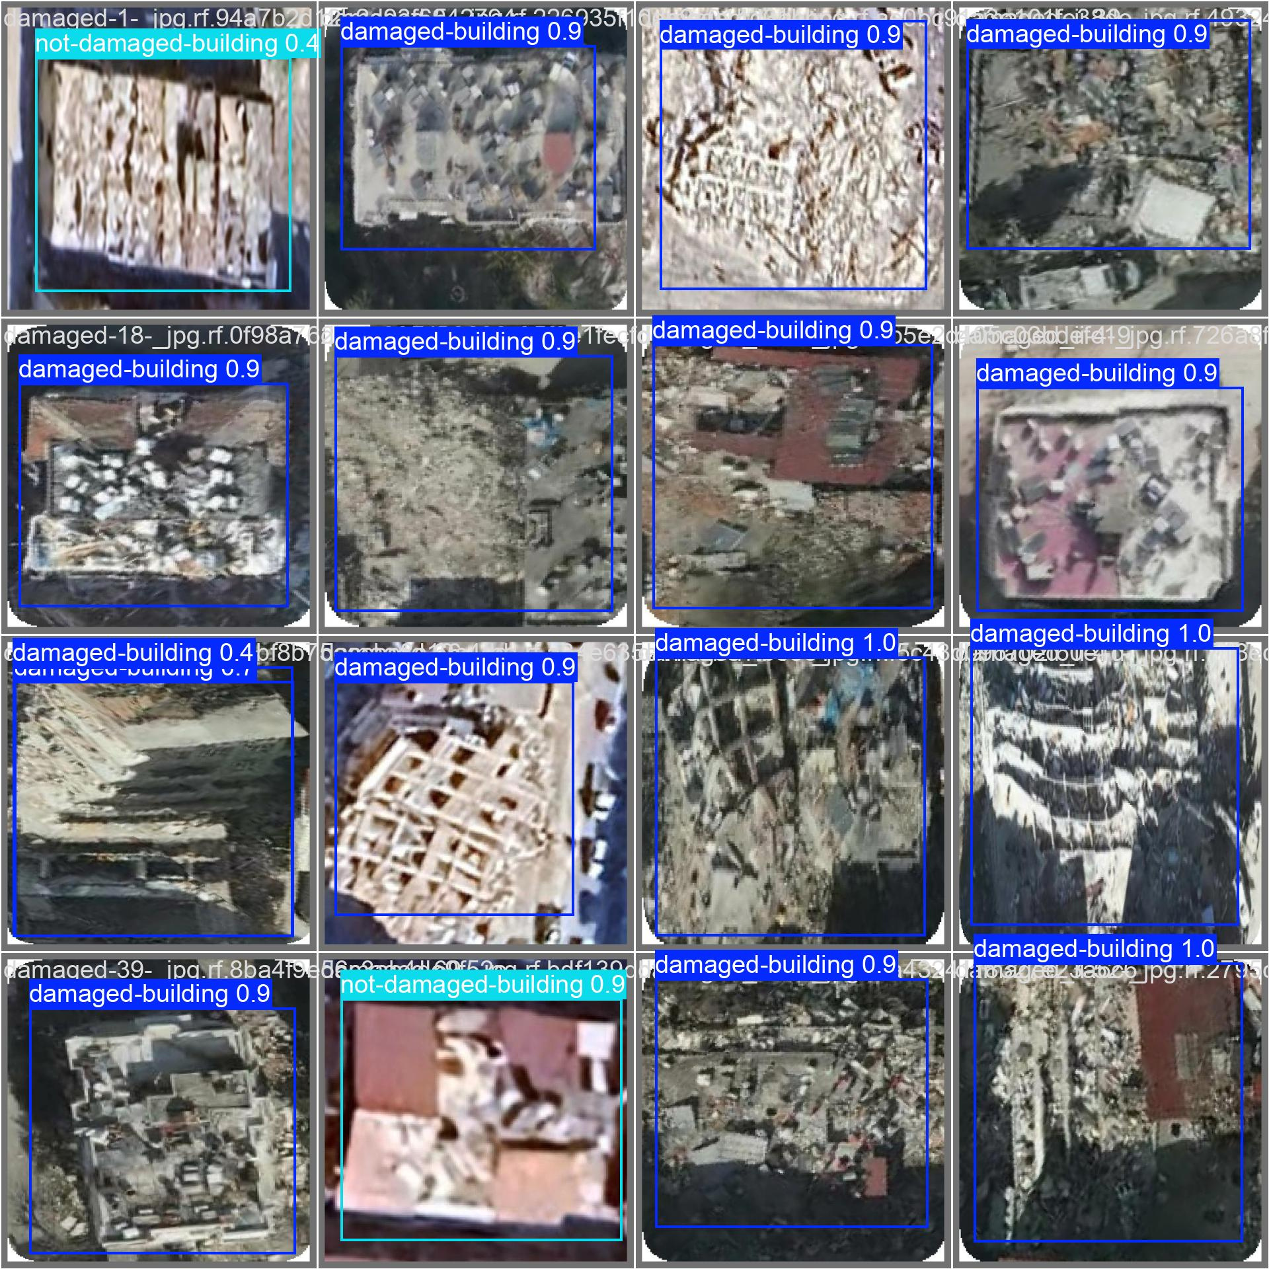
VALIDATION

Slide 19
TEST SAMPLE

Slide 20

THANK YOU !

